Slide 1
EDPY 607 Measurement Theory II
Lecture 2: Psychometric Network Analysis
Okan Bulut, Ph.D.
Centre for Research in Applied Measurement and Evaluation
University of Alberta

Slide 2

Outline
Network science
Gaussian graphical models (GGMs)
How to estimate network models
Psychometric network analysis in education

Slide 3
“Traditional” Views in Psychometrics
In educational and psychological measurement:
Reflective interpretation (e.g., factor analytic models)
The measured attribute is conceptualized as the common cause of the observed variables
Formative interpretation (e.g., principal component analysis)
The measured attribute is seen as the common effect of the observables
A third interpretation???
Limitations of reflective and formative interpretations
The dynamics of the measurement system (e.g., the role of time) are not explicated.
A chicken and egg situation: From a latent variable to observed variables?
Causal relations between the observed indicators are typically ignored.
Measuring latent variables (or components) creates the need for comprehensive validation studies under causal research assumptions.

Slide 4

Network Science

Slide 5

The Network Perspective
In the network science perspective, the attributes are conceptualized as “a system of causal relations between observed variables” (Schmittmann et al., 2013). Constructs are viewed as “dynamical systems” → a network of observed variables
For example, assume that we have a depression inventory with items focused on “lack of sleep,” “fatigue,” and “concentration problems.”
In the traditional psychometric view, we would combine the results from these items and create a single score that represents a person’s level of depression.
In the network science perspective, potential direct relations between symptoms are primarily considered (rather than the construct of depression).
e.g., lack of sleep → fatigue → concentration problems
Researchers using network science believe that:
Investigating a construct means investigating the network (i.e., network structure and network dynamics).
The observed variables do not measure the construct, but are part of it.
Studying the relation between observed variables and the construct means studying the function of the observables in the network.

Slide 6
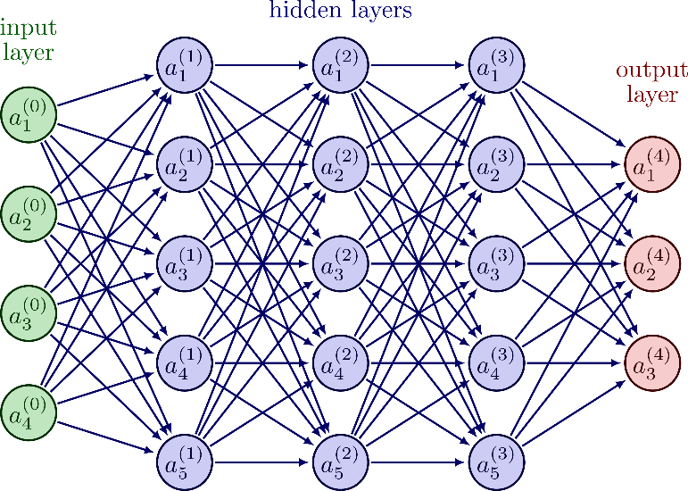

Psychological Networks ≠ Social or Neural Networks

Slide 7
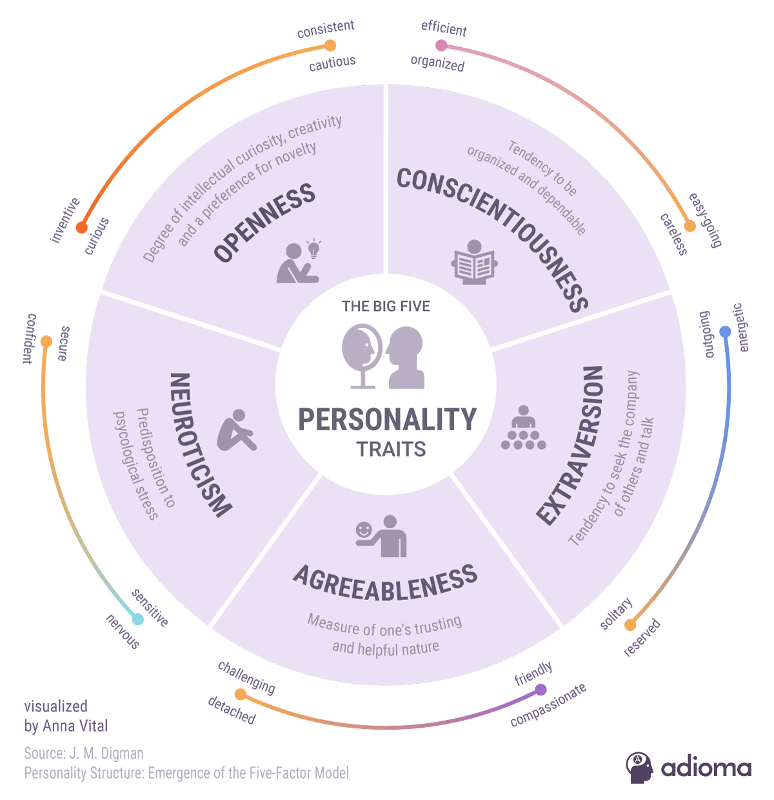

Slide 8
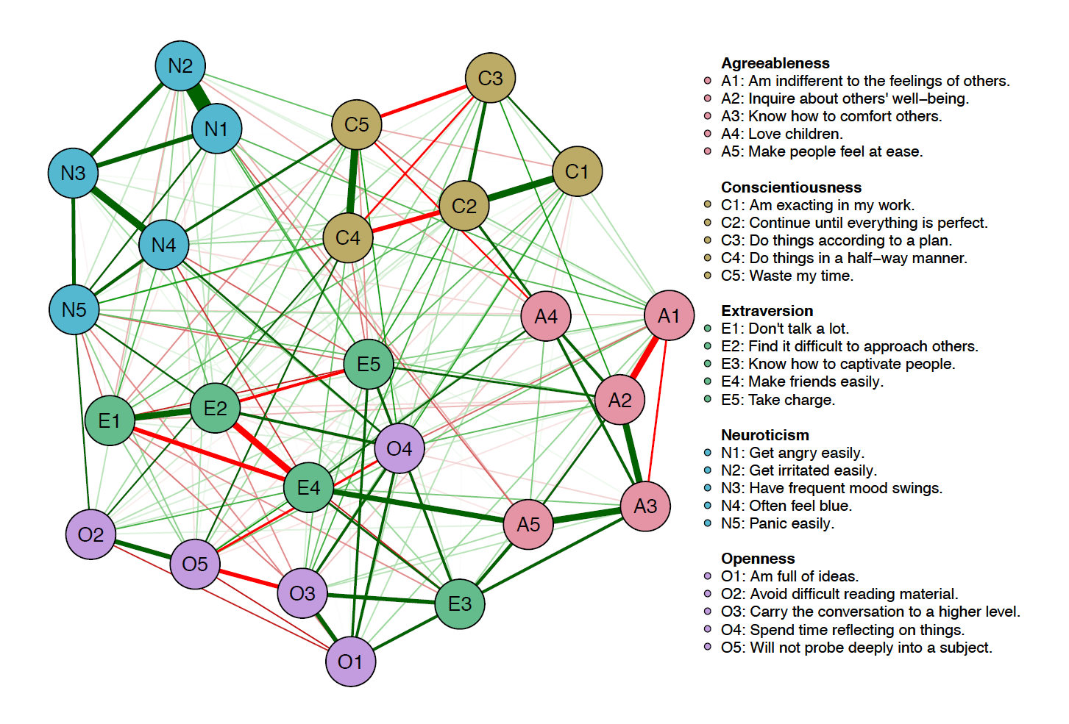
Big Five Personality Test
Source: Epskamp, S. (2017). Network psychometrics (Doctoral dissertation). Amsterdam: University of Amsterdam.

Slide 9
Constructing a Psychological Network
In psychology (and now, in education), researchers typically use undirected network models.
The pairwise Markov Random Field (PMRF) refers to a broad class of statistical models to estimate such network models.
Different PMRF models can be used, depending upon the type of data (i.e., continuous, ordinal, binary, or mixtures of these data types) to be modelled.
The most widely used framework for constructing a psychological network on multivariate data is to estimate a network of “partial correlation” coefficients (McNally et al., 2015).
Such networks are often called Gaussian Graphical Models (GGMs; Costantini et al., 2015).

Slide 10
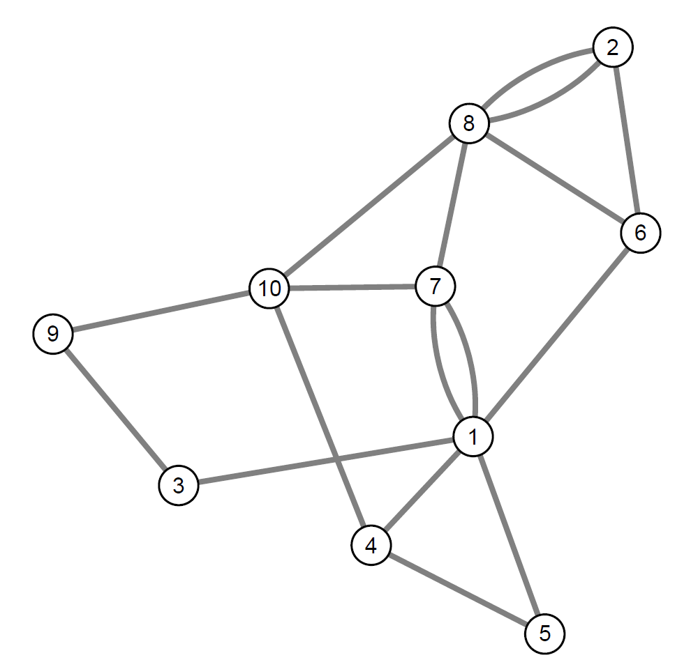
Gaussian Graphical Models
A GGM is a network that consists of n nodes (or vertices) that are connected with m edges.
Each edge has a weight indicating the strength of that connection. An edge can be directed (have an arrow) or undirected.

Slide 11
What is a Partial Correlation?
A partial correlation is the association between two [quantitative] variables, after conditioning on all other variables in the dataset.
Conditioning → Finding the remaining association between two variables after controlling for all other information possible
Known as “conditional” independence associations
Just like regular correlation coefficients, partial correlation coefficients also range from −1 to 1.

Slide 12
Partial Correlations in Network Graphs
When creating network graphs:
Researchers typically use “red” lines for negative partial correlations and “green” lines for positive partial correlations → this facilitates the network interpretation.
Weighted edges: Wider (i.e., thicker) and more saturated lines (i.e., connections) indicate stronger partial correlations (i.e., correlations far from zero).
Unweighted edges: The edge simply represents the presence or absence of a relationship
If partial correlation = 0, no connection is drawn between two nodes, indicating that two variables are independent, after controlling for all other variables in the network.

Slide 13
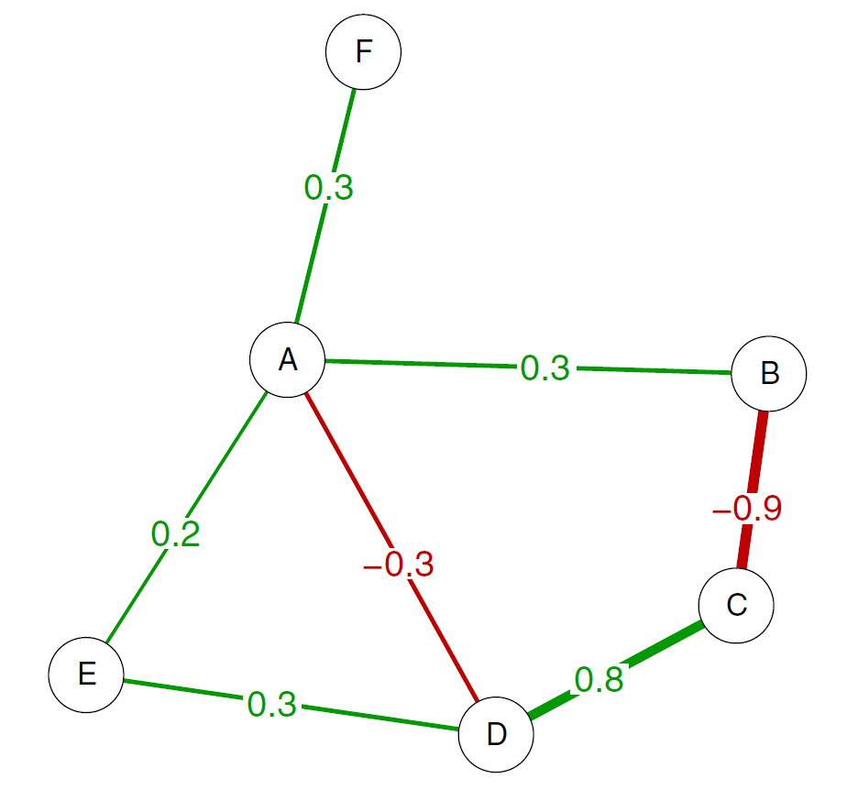
Example – A GGM Network with Weighted Edges
A network with six nodes (i.e., variables) and seven edges. Positive edges are green and negative edges are red.
The letters identify the nodes, the numbers represent weights associated to the edges.
Source: Costantini et al. (2015)

Slide 14
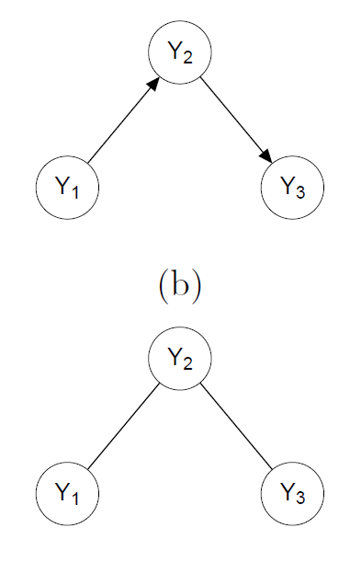
Directed and Undirected Networks
There are two types of edges that can be present in a network:
Directed: One head of the edge has an arrowhead indicating a one-way effect (e.g., the edge insomnia → fatigue indicates that insomnia causes fatigue).
Indirected: It indicates some mutual relationship between two nodes (e.g., two items in an attitude survey can be associated with each other).
Depending on the type of edges, we can build either directed networks (i.e., all edges are directed) or indirected networks (i.e., no edges are directed):

Slide 15
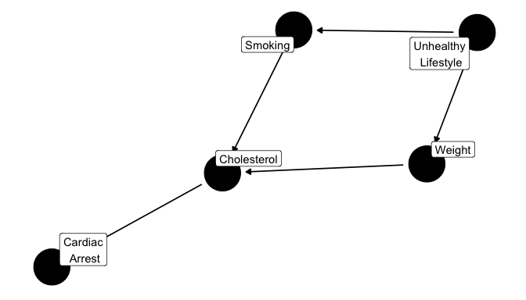
Directed Acyclic Graphs (DAGs)
Directed Cyclic Graphs
In DAGs, you can’t start at a node and end up back at that node again by following the directed edges.
There is at least one path in which one can travel down and return to their starting point.
Source: https://cran.r-project.org/web/packages/ggdag/vignettes/intro-to-dags.html

Slide 16

Why do we need partial correlations (rather than regular correlations) between two variables?

Slide 17

Let’s play a game…

Slide 18
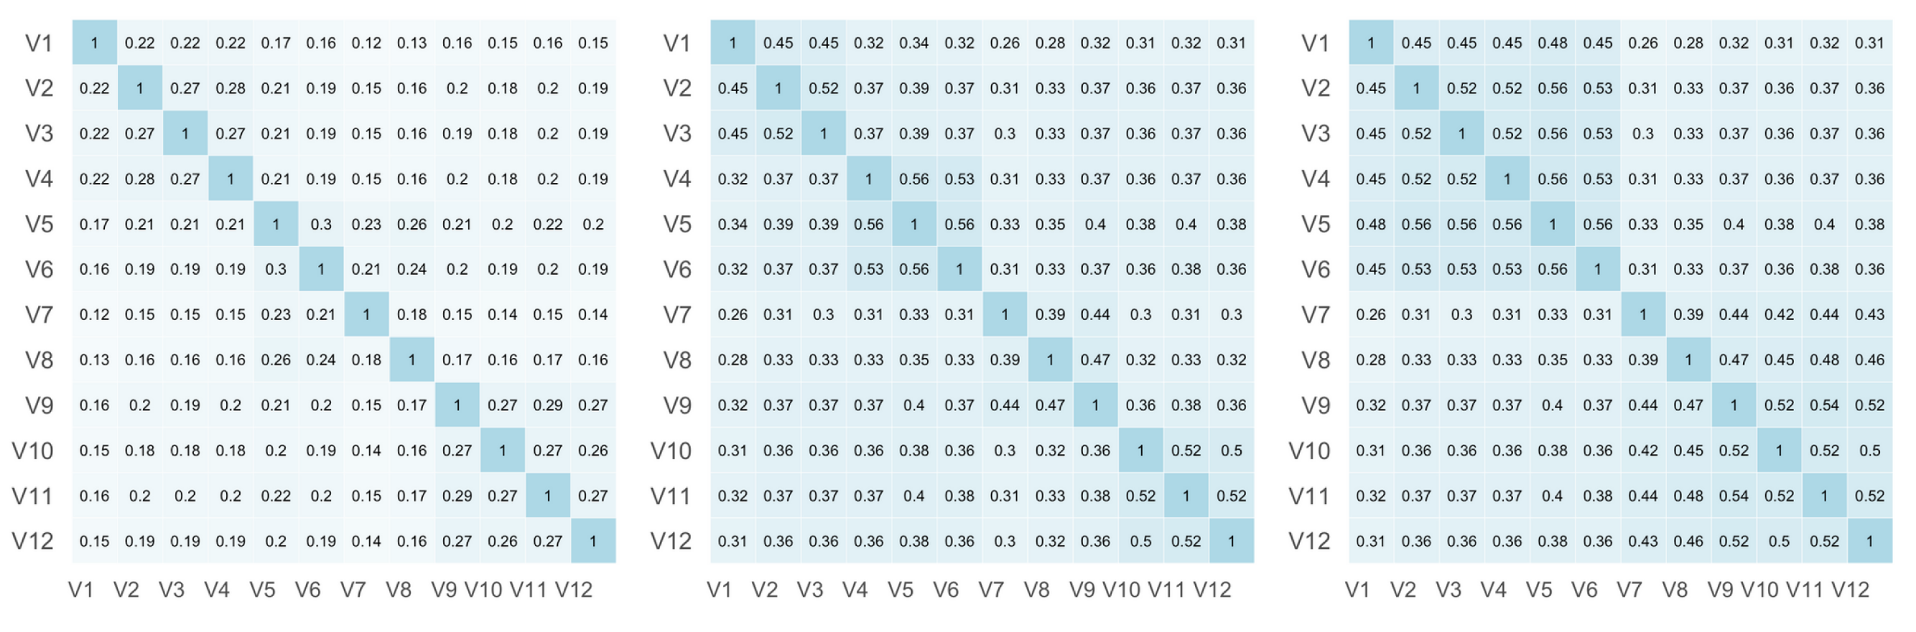
Can you guess the number of factors in the following correlation matrix?

Slide 19
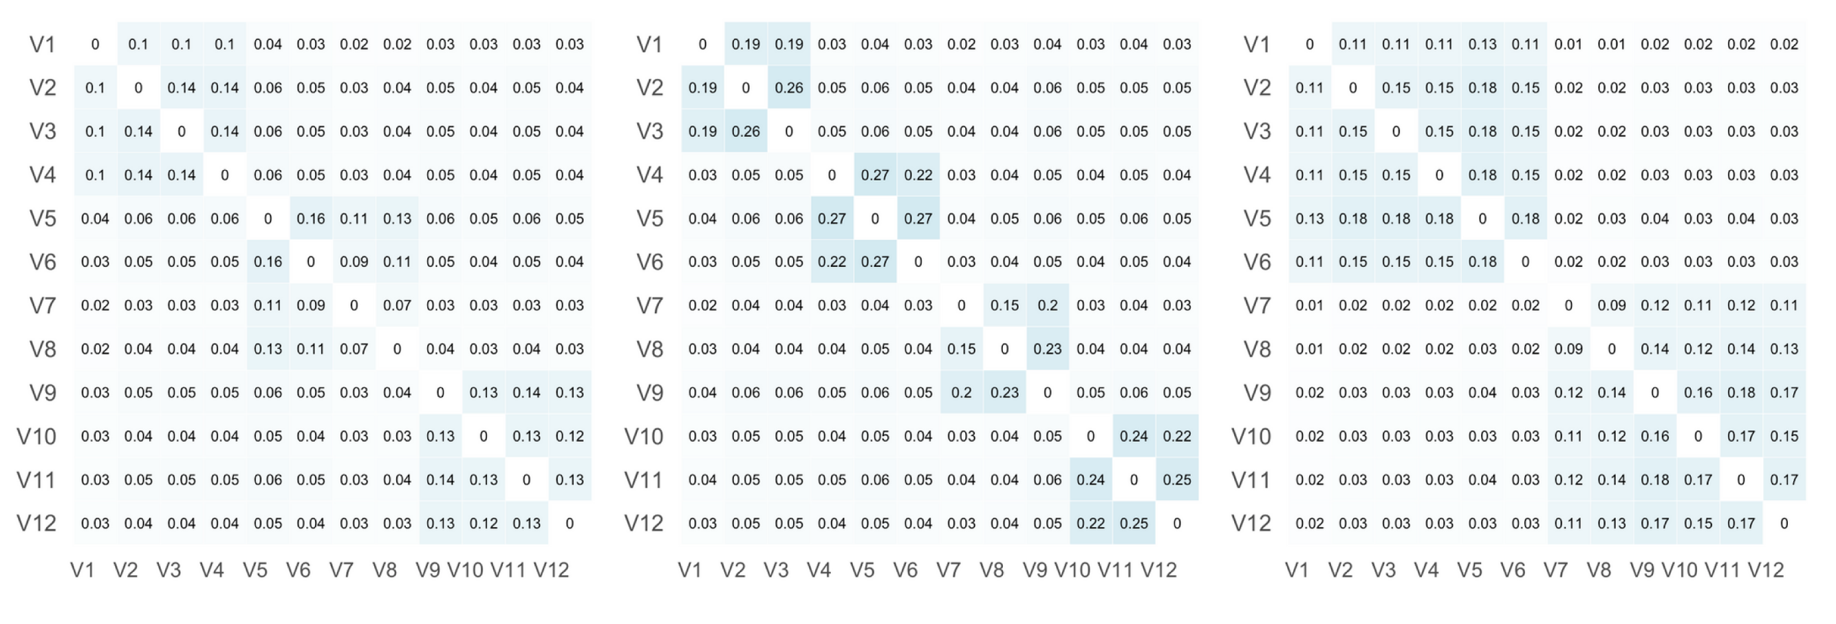
Can you guess the number of factors in the following “partial” correlation matrices?

Slide 20
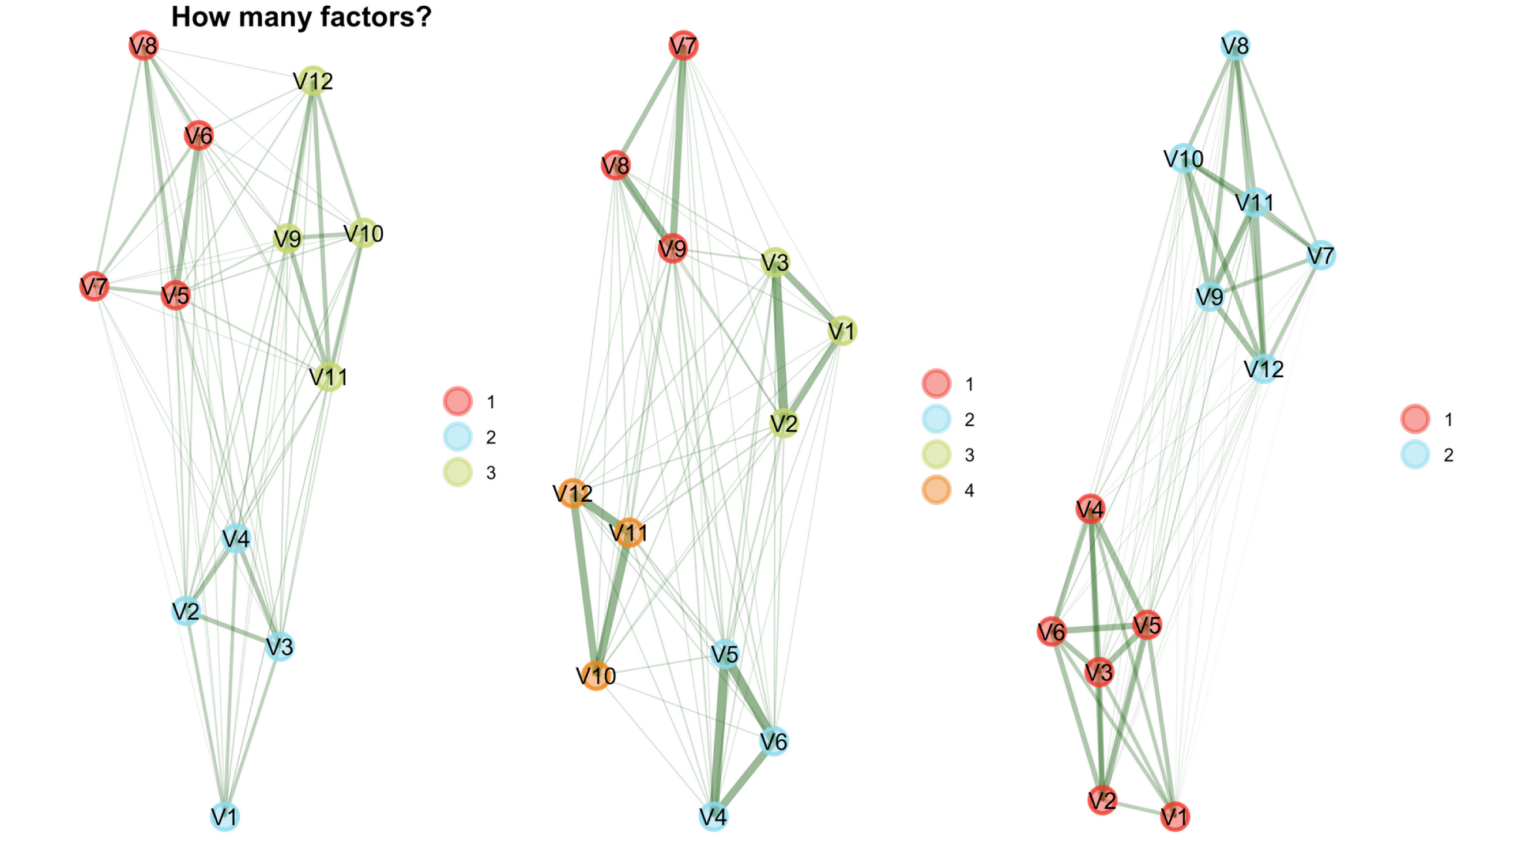

Slide 21
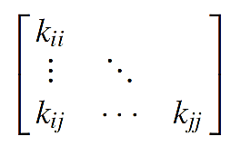
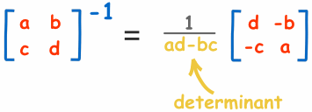
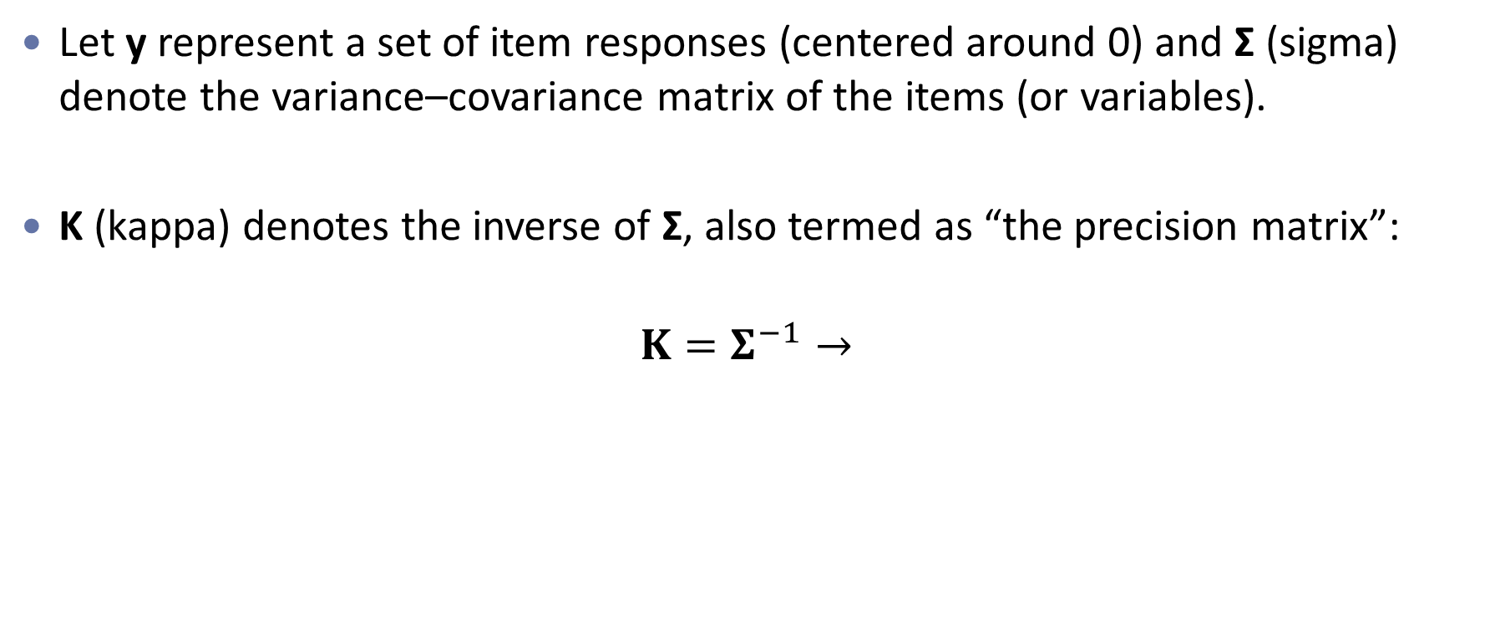
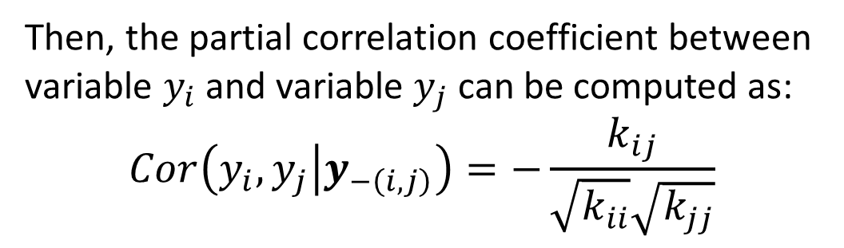
Computing Partial Correlations
Let y represent a set of item responses (centered around 0) and Σ (sigma) denote the variance–covariance matrix of the items (or variables).
Κ (kappa) denotes the inverse of Σ, also termed as “the precision matrix”:
$$Κ=Σ^{−1}→$$
Then, the partial correlation coefficient between variable $y_{i}$ and variable $y_{j}$ can be computed as:
$$Cor\left(y_{i},y_{j} | y_{−\left(i,j\right)}\right)=−\frac{k_{ij}}{\sqrt{k_{ii}}\sqrt{k_{jj}}}$$

Slide 22

Do all partial correlations matter in a network?

Slide 23

“Regularized” Partial Correlation
Estimating parameters from data always comes with sampling variation, leading to estimates that are never exactly zero.
Even when two variables are conditionally independent, we still obtain small partial correlations → represented as very weak edges in the network, called spurious or false positives (Costantini et al., 2015).
To prevent over-interpretation in network structures, we want to limit the number of spurious connections.
It is possible to eliminate spurious connections using statistical regularization techniques, such as “least absolute shrinkage and selection operator” (LASSO; Tibshirani, 1996).
LASSO (L₁) regularization shrinks partial correlation coefficients when estimating a network model, which means that small coefficients are estimated to be exactly zero → a sparse network

Slide 24
From LASSO to Graphical LASSO
LASSO refers to the methodological approach that can be applied to various problems in data science, such as feature selection or regularization.
LASSO can enhance prediction accuracy and model interpretability.
When a LASSO penalty is applied to the inverse covariance matrix, it helps the estimation of sparse (undirected) graphical models.
This method is specifically called graphical LASSO, or shortly glasso (Friedman et al., 2008), in the literature.
glasso is a sparse penalized maximum likelihood estimator for the precision matrix (inverse of covariance matrix of Κ) of a multivariate distribution.

Slide 25
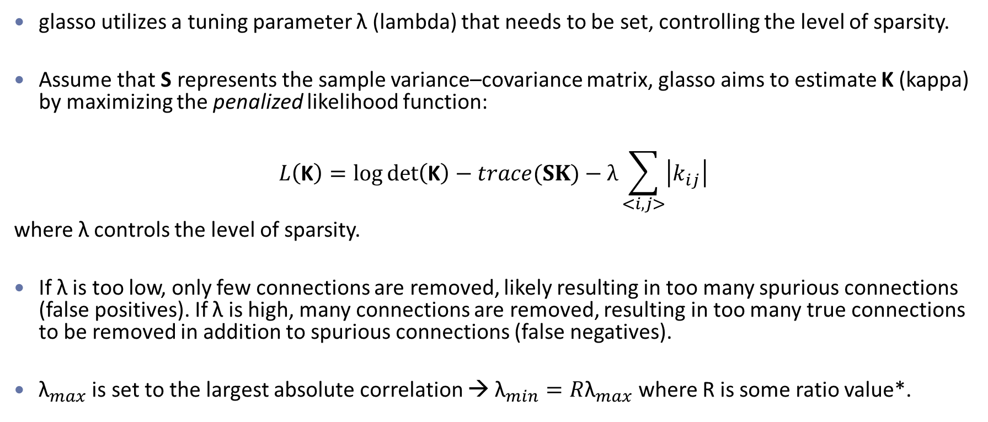
How Does glasso Work?
glasso utilizes a tuning parameter λ (lambda) that needs to be set, controlling the level of sparsity.
Assume that S represents the sample variance–covariance matrix, glasso aims to estimate Κ (kappa) by maximizing the penalized likelihood function:
$$L\left(\text{Κ}\right)=\log{\det\left(\text{Κ}\right)−trace(SΚ)−λ}\sum_{<i,j>}{\left|k_{ij}\right|}$$
where λ controls the level of sparsity.
If λ is too low, only few connections are removed, likely resulting in too many spurious connections (false positives). If λ is high, many connections are removed, resulting in too many true connections to be removed in addition to spurious connections (false negatives).
${\text{λ}}_{max}$ is set to the largest absolute correlation → ${\text{λ}}_{min}=R{\text{λ}}_{max}$ where R is some ratio value*.
the sum of the elements on the main diagonal.
*The qgraph package uses R = 0.01 by default.

Slide 26
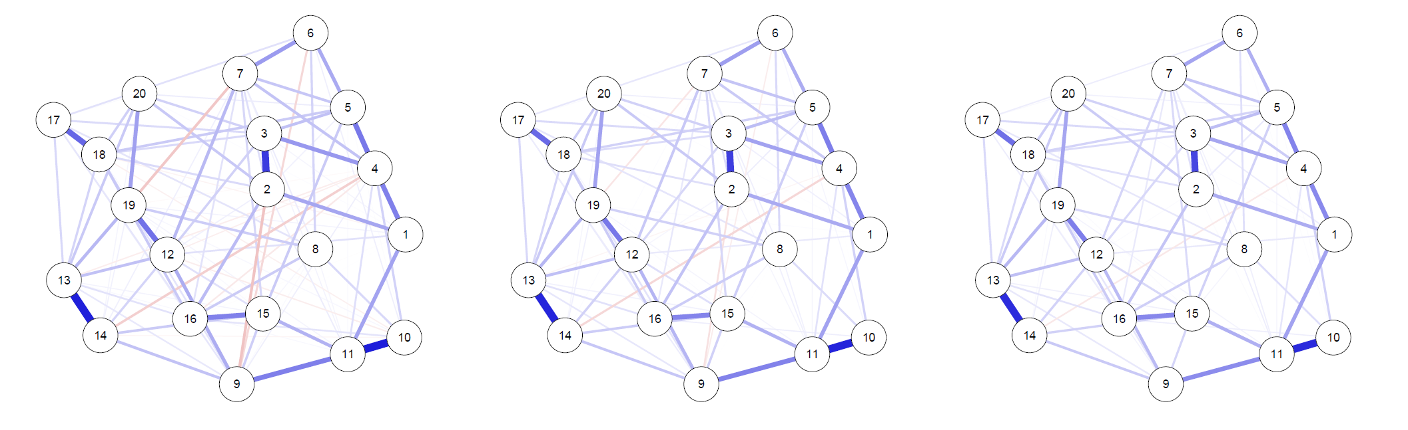
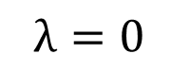
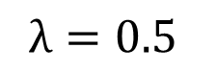
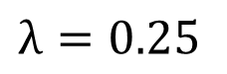
Partial Correlation Networks Estimated on Responses of
221 Subjects on 20 PTSD Symptoms
$$λ=0$$
$$λ=0.25$$
$$λ=0.5$$
Source: Epskamp and Fried (2017)

Slide 27
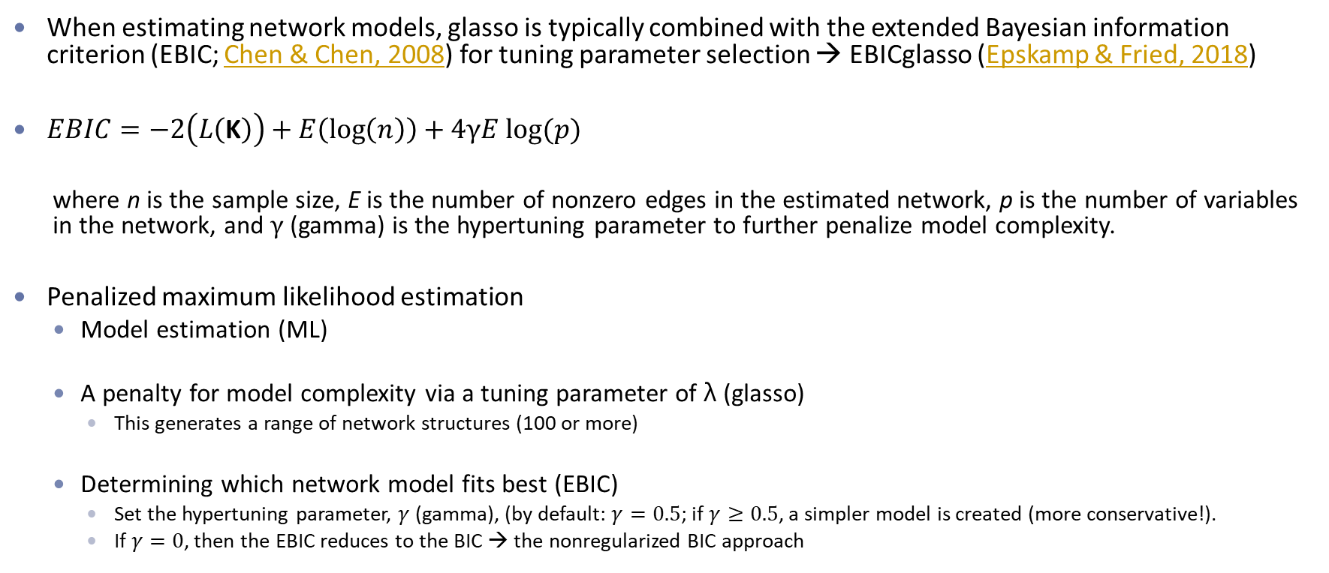
EBIC glasso
When estimating network models, glasso is typically combined with the extended Bayesian information criterion (EBIC; Chen & Chen, 2008) for tuning parameter selection → EBICglasso (Epskamp & Fried, 2018)
$EBIC=−2\left(L\left(\text{Κ}\right)\right)+E\left(\log\left(n\right)\right)+4γE log⁡(p)$
where n is the sample size, E is the number of nonzero edges in the estimated network, p is the number of variables in the network, and $γ$ (gamma) is the hypertuning parameter to further penalize model complexity.
Penalized maximum likelihood estimation
Model estimation (ML)
A penalty for model complexity via a tuning parameter of λ (glasso)
This generates a range of network structures (100 or more)
Determining which network model fits best (EBIC)
Set the hypertuning parameter, $γ$ (gamma), (by default: $γ=0.5$; if $γ≥0.5$, a simpler model is created (more conservative!).
If $γ=0$, then the EBIC reduces to the BIC → the nonregularized BIC approach

Slide 28
Centrality Measures
Measures of centrality provide insight into the relative importance of a node in the context of the other nodes in the network.
The most commonly used centrality measures (or indices) are:
Degree: The number of connections incident to the node of interest.
Node strength: The sum of the absolute edge weights of edges per node.
A tuning α (alpha) parameter: 0 to 1: a high degree is favorable; α > 1: a low degree is favorable.
Closeness: The distance between the node and all other nodes by averaging the shortest path lengths to all other nodes (indicating the node’s relationship to all other nodes in the network)
A central node with high closeness is affected quickly by changes in any part of the network and can affect changes in other parts of the network quickly.
Betweenness: How often a node lies on the shortest path connecting any two other nodes.
A node can play a key role in the network if it frequently lies on the shortest path between two other nodes.
The stability of centrality indices can be examined by estimating network models based on subsets of the data (e.g., finding the range of each index across 1000 samples via bootstrapping)
Notes:
For example, a node with many weak connections (high degree) might not be as central to the network as one that has fewer but stronger connections.

Slide 29
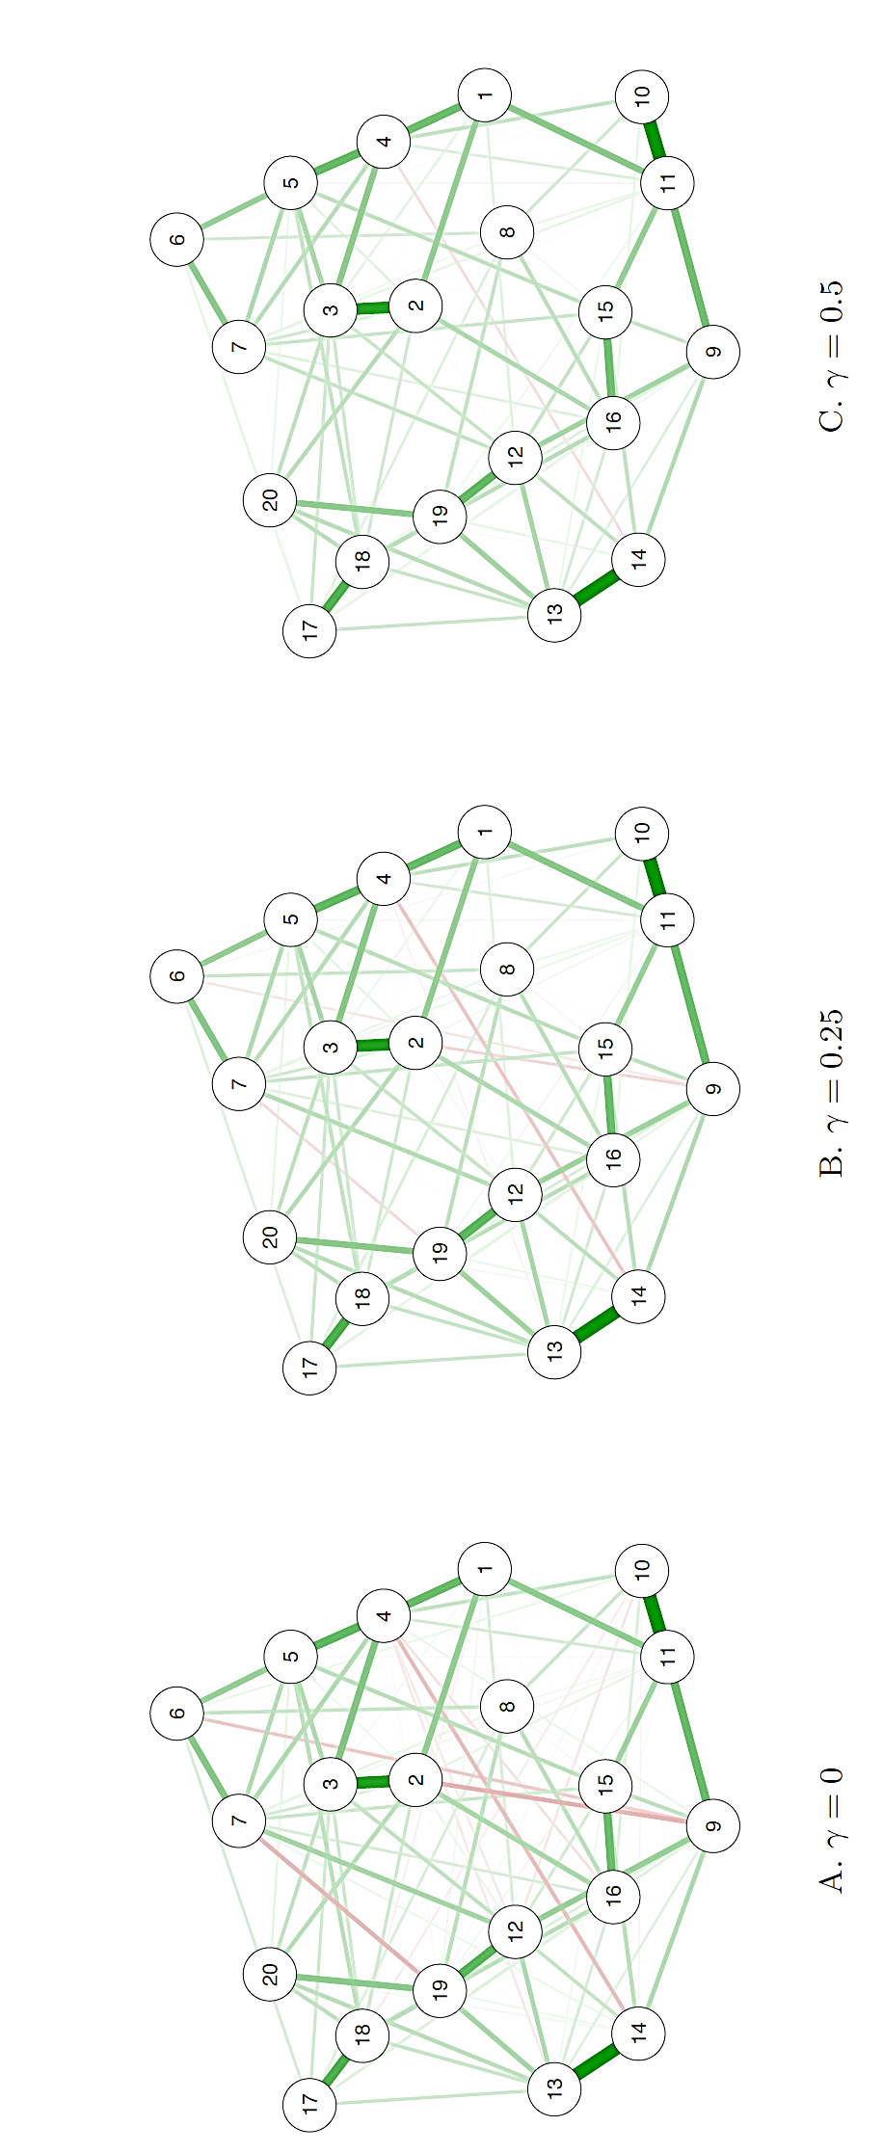
Example – Centrality Measures
Source: Epskamp, S. (2017). Network psychometrics (Doctoral dissertation). Amsterdam: University of Amsterdam.

Slide 30
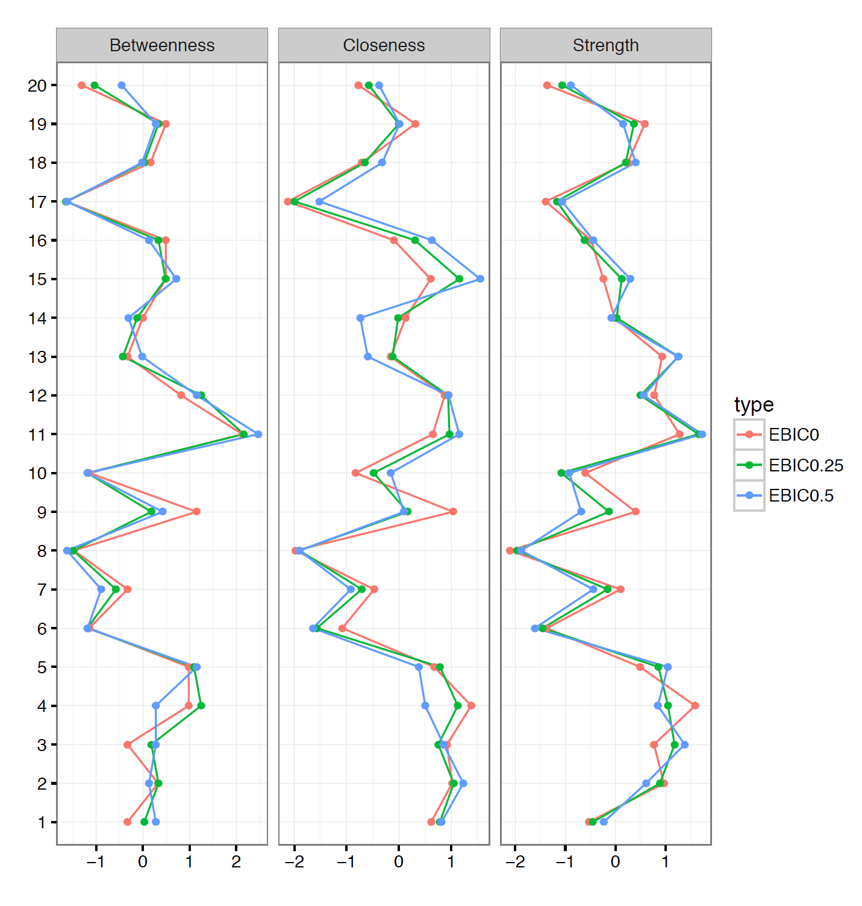
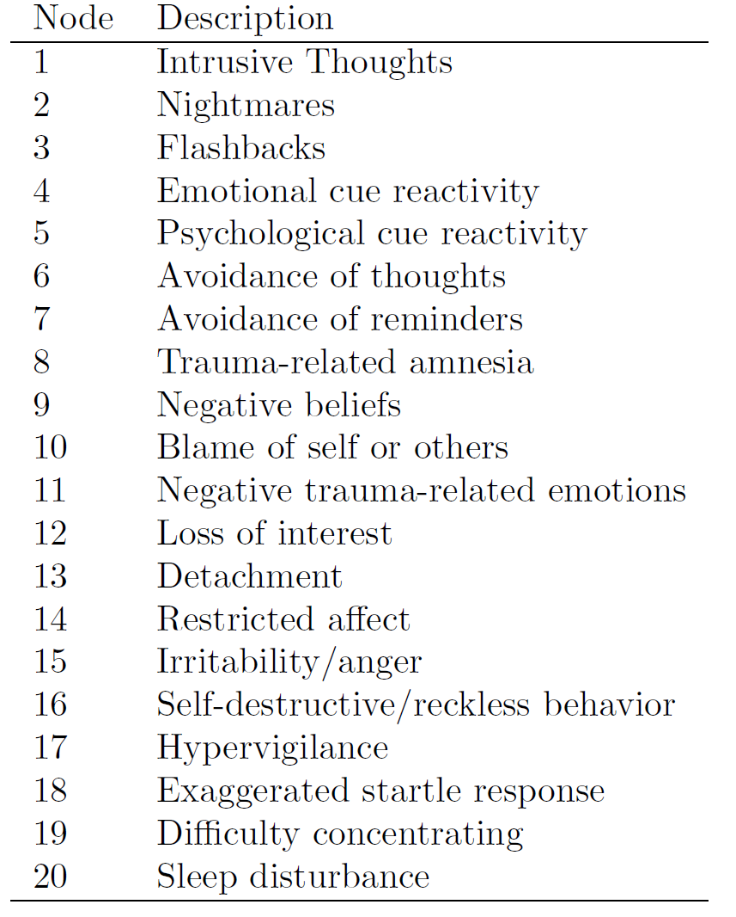

Slide 32

Are network models exploratory or confirmatory?

Slide 33
Some Notes about Network Models
Main advantage of using network models
Ability to estimate and represent patterns of conditional associations without requiring strong a priori assumptions, making this approach highly suitable for exploratory data analysis and theory generation.
Reproducibility of network structures
Due to sampling variability and random measurement error, one should not ordinarily expect to reproduce the network completely.
Confirmatory testing
Most applications of network analysis use exploratory techniques to estimate network structures.
However, it is possible use network models in a confirmatory fashion (see the psychonetrics R package for more examples):
Constrain parameters (such as edge weights) to a specific value
Constrain edges to have the same edge weight as each other
Constrain edge weights to be equal across different groups
Causal inference
Since GGMs (or more broadly PMRFs) are based on purely statistical associations, direct causal inference based on network structures is not justified.

Slide 34

Network Models Depending on Data Type
If continuous data are multivariate normally distributed, then use a Gaussian graphical model (GGM) based on partial correlations.
If the continuous data are not normally distributed, then a transformation (e.g., nonparanormal transformation, Liu et al. 2009) must be applied prior to applying the GGM.
GGM can also be used for ordinal data (e.g., Likert-scale data) wherein the network is based on the polychoric correlations instead of partial correlations (Epskamp, 2018).
If all the variables are binary (e.g., dichotomous test items), then the Ising Model should be used (van Borkulo et al., 2014).
When the data comprise a mixture of categorical and continuous variables, the Mixed Graphical Model can be used to estimate the PMRF (Haslbeck & Waldorp, 2016).
Notes:
https://www.stat.cmu.edu/~larry/=sml/NonparGraphs.pdf

Slide 35

Food for Thought
Christensen, A. P., & Golino, H. (2021). Factor or network model? Predictions from neural networks. Journal of Behavioral Data Science, 1(1), 85-126. https://doi.org/10.35566/jbds/v1n1/p5
Fourrier, C. (2023). Introduction to graph machine learning. Retrieved from https://huggingface.co/blog/intro-graphml
Kim, J., Nguyen, T. D., Min, S., Cho, S., Lee, M., Lee, H., & Hong, S. (2022). Pure transformers are powerful graph learners. arXiv preprint arXiv:2207.02505. Retrieved from https://arxiv.org/abs/2207.02505
A gentle introduction to graph neural networks
https://distill.pub/2021/gnn-intro/

Slide 36


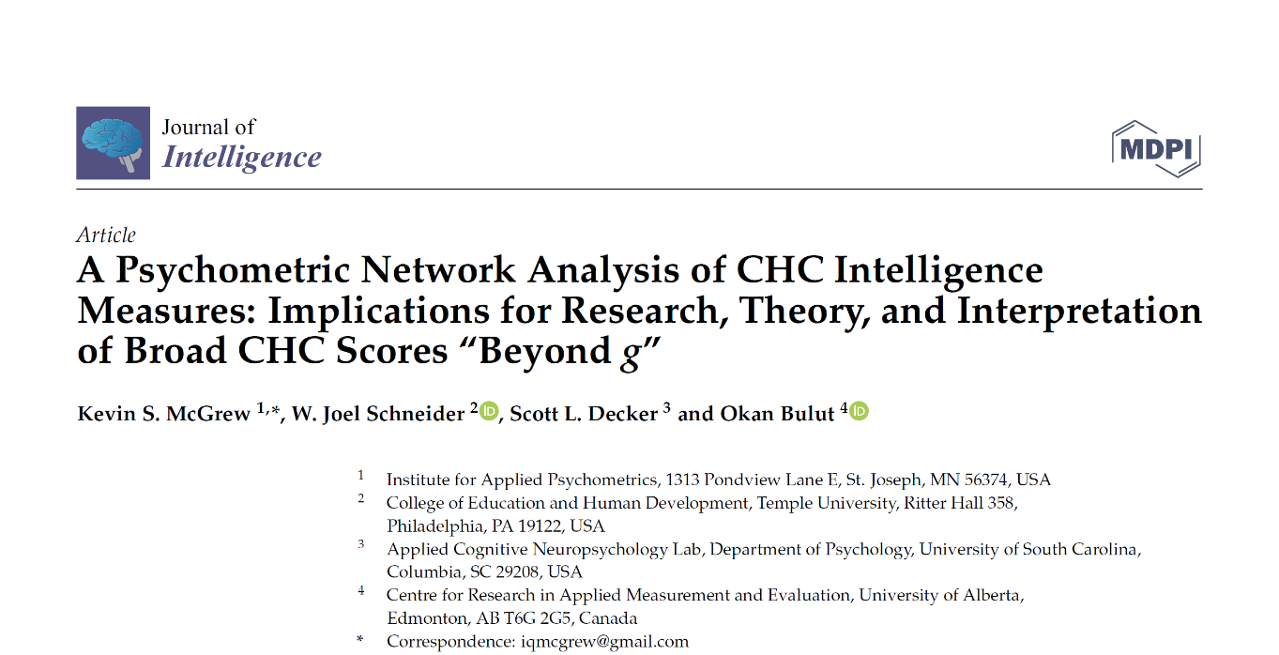
https://www.mdpi.com/2079-3200/9/3/35/htm
https://www.mdpi.com/2079-3200/11/1/19

Slide 37

How to Use Psychometric Network Analysis in Education

Slide 38
Evaluating Dimensionality
New method → Exploratory Graph Analysis (EGA; Golino & Epskamp, 2017)
If there are latent factor(s) underlying the items, then:
The off-diagonal blocks of the precision matrix K will be scaled closer to zero than the diagonal blocks of K.
Hence, we should see weighted item cluster(s) (or communities) for each factor in the GGM.
If the latent factors are orthogonal (i.e., uncorrelated), the resulting GGM should consist of unconnected clusters.

Slide 39
Evaluating Structural Consistency & Item Stability
Structural Consistency
The proportion of times that each empirically derived
dimension (i.e., the result from the initial EGA) was exactly recovered (i.e., identical item composition) from the bootstrap samples.
Source: Christensen, A. P., & Golino, H. (2021). Estimating the stability of psychological dimensions via bootstrap exploratory graph analysis: A Monte Carlo simulation and tutorial. Psych, 3(3), 479-500.

Slide 40
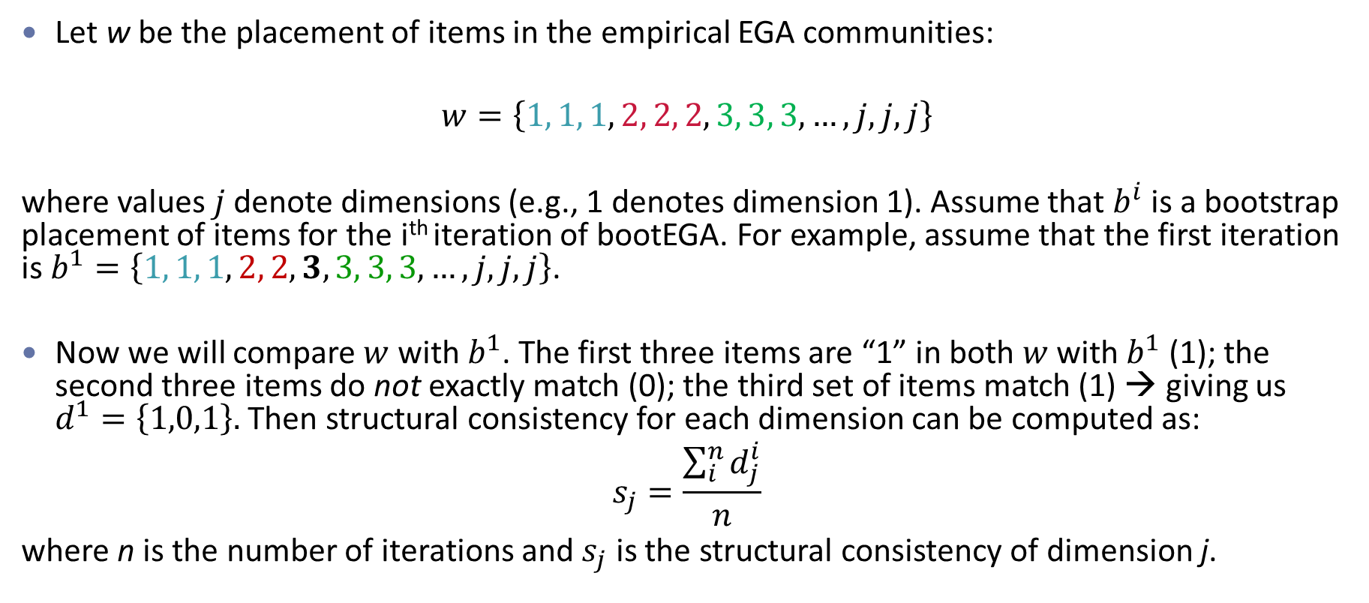
Evaluating Structural Consistency & Item Stability
Let w be the placement of items in the empirical EGA communities:
$$w=\left\{1, 1, 1, 2, 2, 2, 3, 3, 3,…, j, j, j\right\}$$
where values $j$ denote dimensions (e.g., 1 denotes dimension 1). Assume that $b^{i}$ is a bootstrap placement of items for the i^{th} iteration of bootEGA. For example, assume that the first iteration is $b^{1}=\left\{1, 1, 1, 2, 2, 3, 3, 3, 3,…, j, j, j\right\}$.
Now we will compare $w$ with $b^{1}$. The first three items are “1” in both $w$ with $b^{1}$ (1); the second three items do not exactly match (0); the third set of items match (1) → giving us $d^{1}=\left\{1,0,1\right\}.$ Then structural consistency for each dimension can be computed as:
$$s_{j}=\frac{\sum_{i}^{n}{d_{j}^{i}}}{n}$$
where n is the number of iterations and $s_{j}$ is the structural consistency of dimension j.

Slide 41
Evaluating Structural Consistency & Item Stability
Item Stability
An index of the robustness of each item’s placement within each empirically derived dimension. It is estimated by computing the proportion of times each item is placed in each dimension (via bootstrapping)
Source: Christensen, A. P., & Golino, H. (2021). Estimating the stability of psychological dimensions via bootstrap exploratory graph analysis: A Monte Carlo simulation and tutorial. Psych, 3(3), 479-500.

Slide 42
Evaluating Structural Consistency & Item Stability
Bootstrap Exploratory Graph Analysis (bootEGA; Christensen & Golino, 2021)
Parametric: Estimating the empirical correlation matrix and using it to generate multivariate normal data
Nonparametric: Resampling with a replacement from the empirical dataset (more useful when the underlying distribution is unknown or non-normal)
bootEGA procedure:
Generate new data (using method #1 or #2 above)
Perform EGA for each replicate sample → creating a sampling distribution of EGA results
Continue this process iteratively until the desired number of samples is achieved
Evaluate the stability of dimensions (i.e., structural consistency) and items (i.e., item stability) across bootstrap replicates

Slide 43
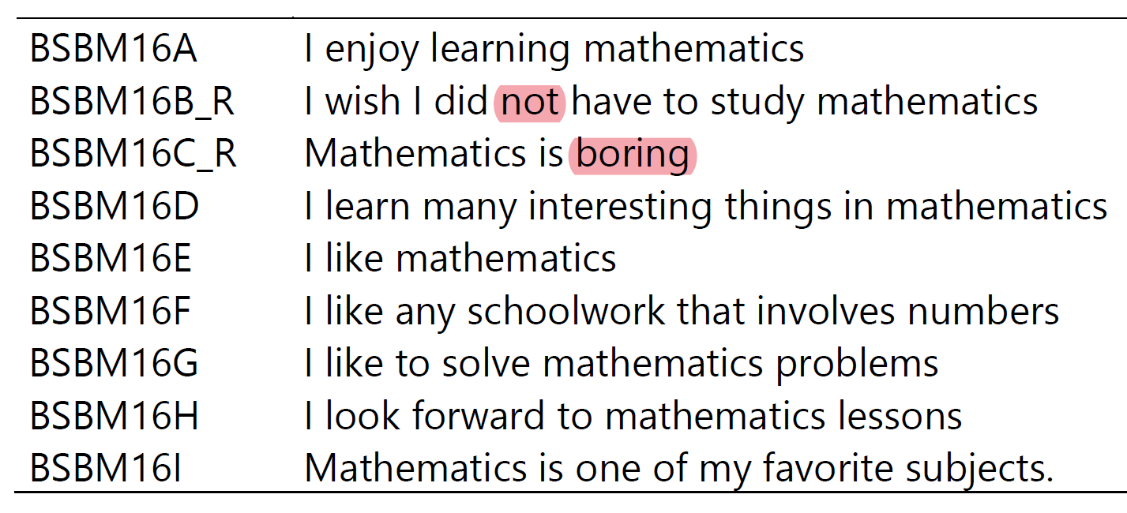
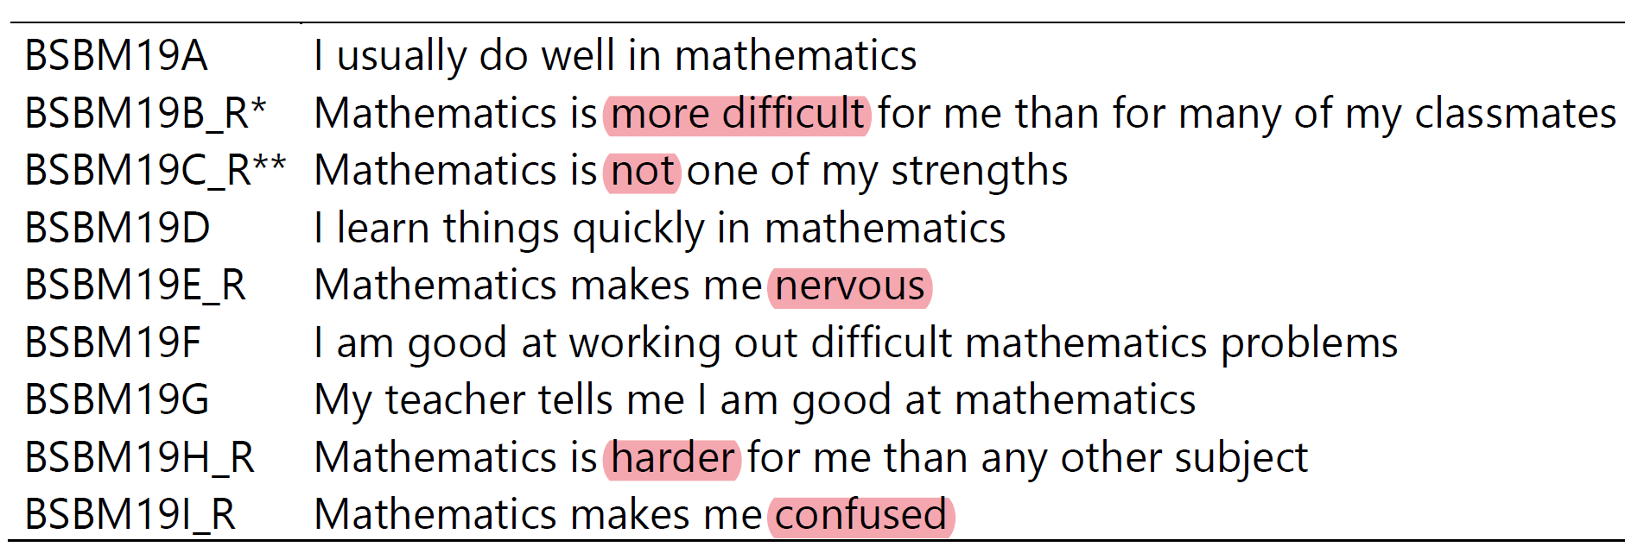
Evaluating Item Wording Effects
“Students Like Learning Mathematics” in TIMSS 2019
Negation
Negative connotation
1 = Disagree a lot 2 = Disagree 3 = Agree 4 = Agree a lot
4 = Disagree a lot 3 = Disagree 2 = Agree 1 = Agree a lot
“Students Confident in Mathematics” in TIMSS 2019

Slide 44
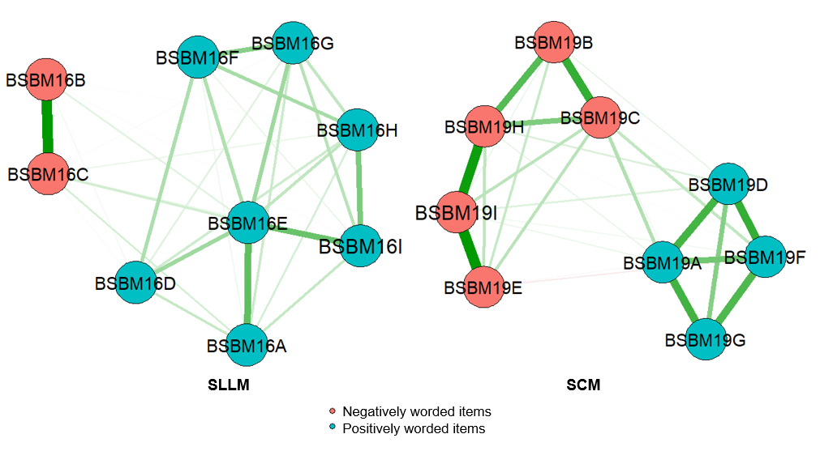
Evaluating Item Wording Effects
Students Like Learning Mathematics (SLLM)
Students Confident in Mathematics (SCM)
Source: Bulut, H. C., & Bulut, O. (2022, April). A network psychometrics approach for detecting item wording effects across subgroups. Paper presented at the annual meeting of the National Council on Measurement in Education, San Diego, CA.
Positively-worded items
Negatively-worded items

Slide 45
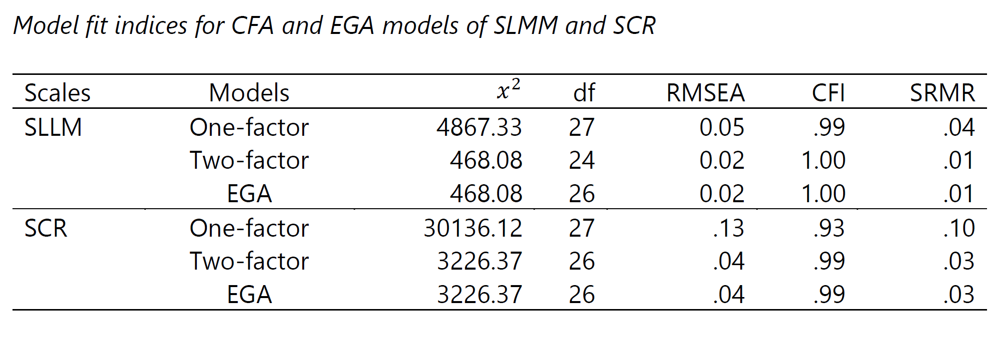
Evaluating Item Wording Effects
Source: Bulut, H. C., & Bulut, O. (2022, April). A network psychometrics approach for detecting item wording effects across subgroups. Paper presented at the annual meeting of the National Council on Measurement in Education, San Diego, CA.

Slide 46
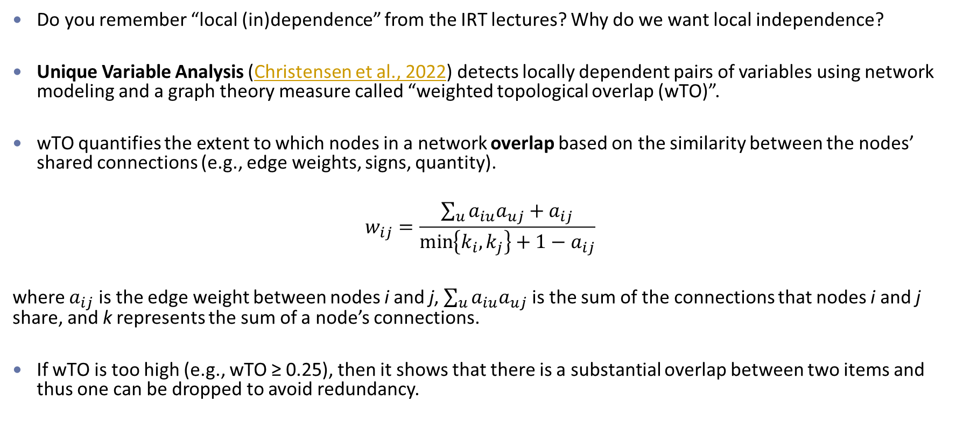
Detecting Local Dependence
Do you remember “local (in)dependence” from the IRT lectures? Why do we want local independence?
Unique Variable Analysis (Christensen et al., 2022) detects locally dependent pairs of variables using network modeling and a graph theory measure called “weighted topological overlap (wTO)”.
wTO quantifies the extent to which nodes in a network overlap based on the similarity between the nodes’ shared connections (e.g., edge weights, signs, quantity).
$$w_{ij}=\frac{\sum_{u}{a_{iu}a_{uj}+a_{ij}}}{\min\left\{k_{i},k_{j}\right\}+1−a_{ij}}$$
where $a_{ij}$ is the edge weight between nodes i and j, $\sum_{u}{a_{iu}a_{uj}}$ is the sum of the connections that nodes i and j share, and k represents the sum of a node’s connections.
If wTO is too high (e.g., wTO ≥ 0.25), then it shows that there is a substantial overlap between two items and thus one can be dropped to avoid redundancy.
Notes:
Shared semantic references, such as similar item phrasing or item content, can create similar response patterns that lead to conditional dependence between items (Reise, Bonifay, & Haviland, 2018; Rosenbusch, Wanders, & Pit, 2020).

Slide 47

Additional Resources
https://doi.org/10.4324/9781003111238
https://www.researchgate.net/publication/313344229_Network_Psychometrics

Slide 48

Potential Research Topics
The integration of IRT and psychometric network models is still uncharted territory (especially for dichotomous data).
Using alternative types of data in psychometric network models (e.g., response times, log data, etc.)
If you are interested in using psychometric network models for your final project, feel free to contact me (I have some ongoing/planned projects focused on network models).

Slide 49
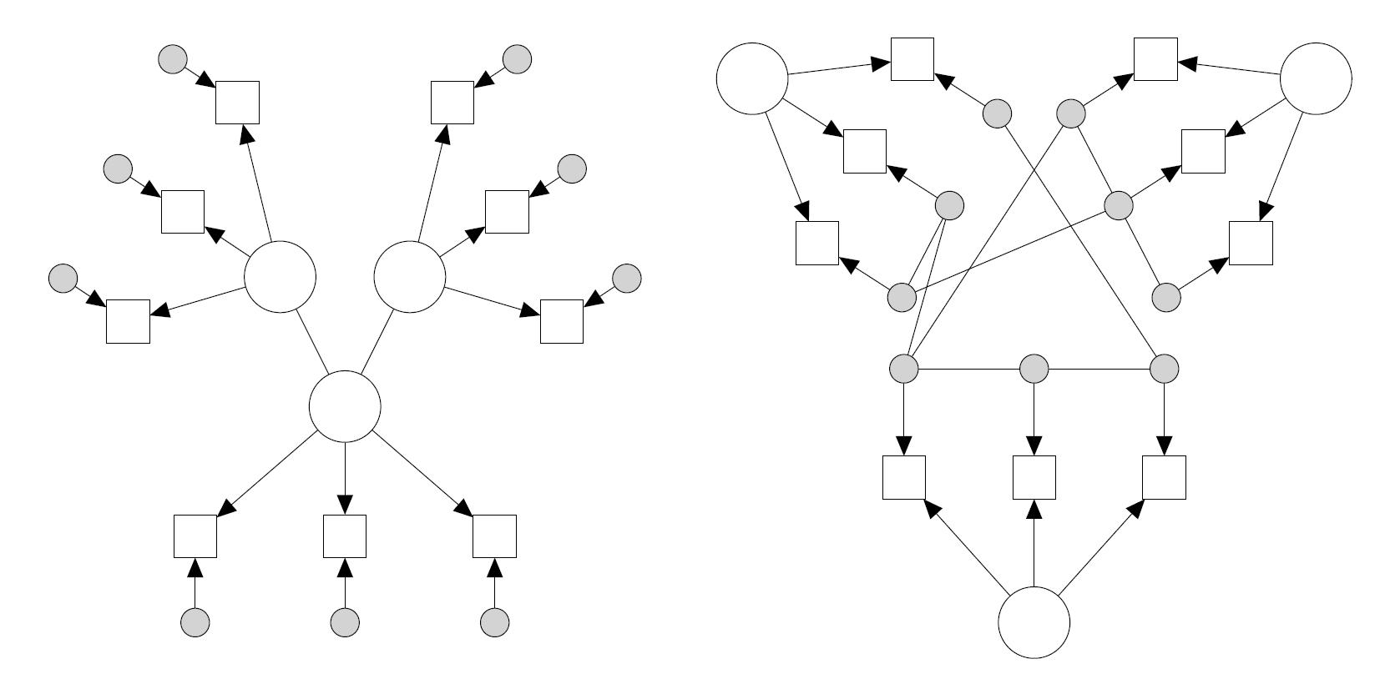
Potential Research Topics
Latent Network Modeling
Residual Network Modeling
Source: Epskamp, S., Rhemtulla, M., & Borsboom, D. (2017). Generalized network psychometrics: Combining network and latent variable models. Psychometrika, 82(4), 904-927.

